Slide 1
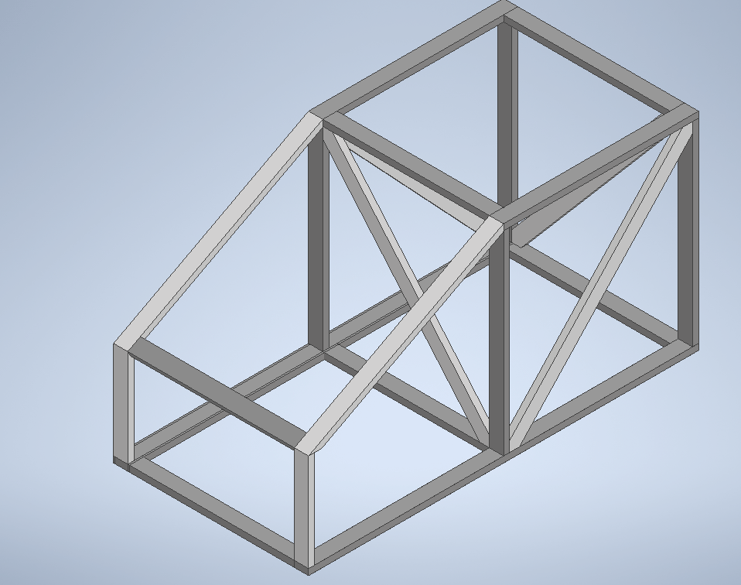

Back Foot Instructions (x2)

Slide 2
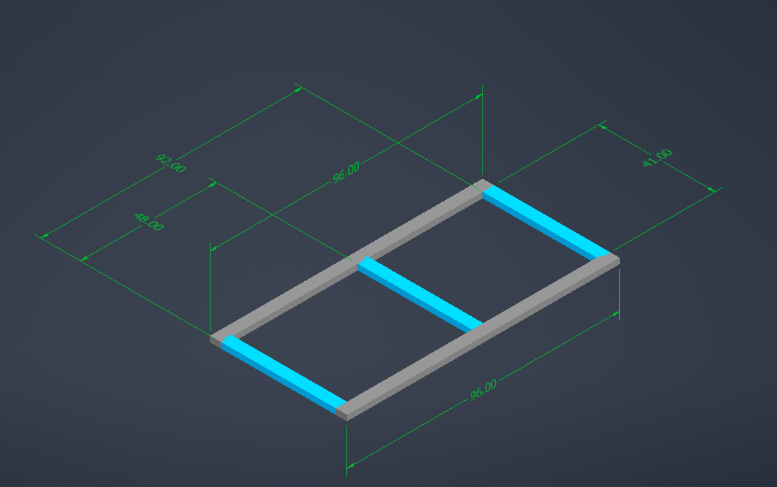
Example Instructions
(2) 2x4x96 (8') (GRAY)
(2) 2x4x96 (3'5'') (BLUE)
First number in parentheses tells you how many board you need to cut, the 2x4xVV value is the length of board, the next value is the length of the cut, and the final part is the color it is in the image. Additional instructions will be provided throughout.

Slide 3
Cut List
(10) 2x4x8
  (2 boards) → (1) 96” per board
  (3 boards) → (2) 48” per board
  (3 boards) → (2) 41” per board
  (2 boards) → (1) 24” + (1) S66
(1) 2x4x10
  (1 board) → (2) S55
(1) 2x4x12
  (1 board) → (2) S66
  Label all boards as you cut and keep track!

Slide 4
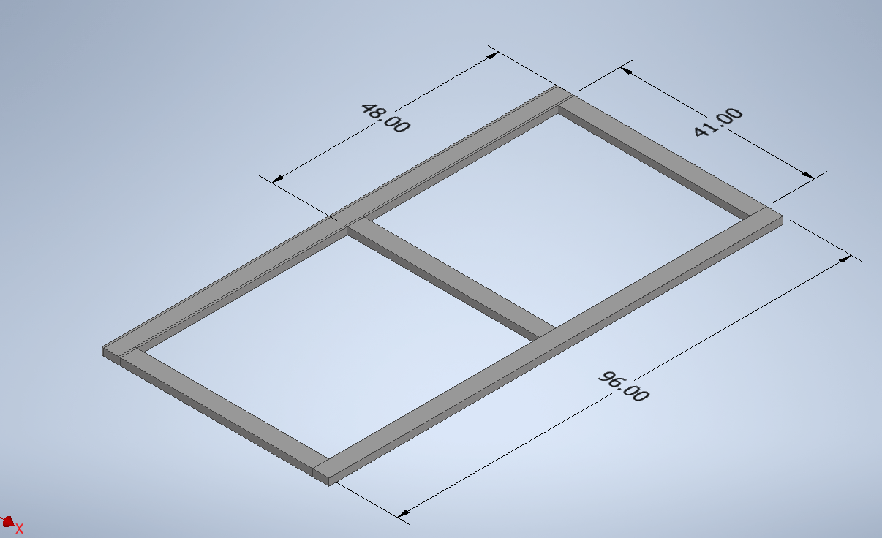
Base
(2) 96"
(3) 41''

Slide 5
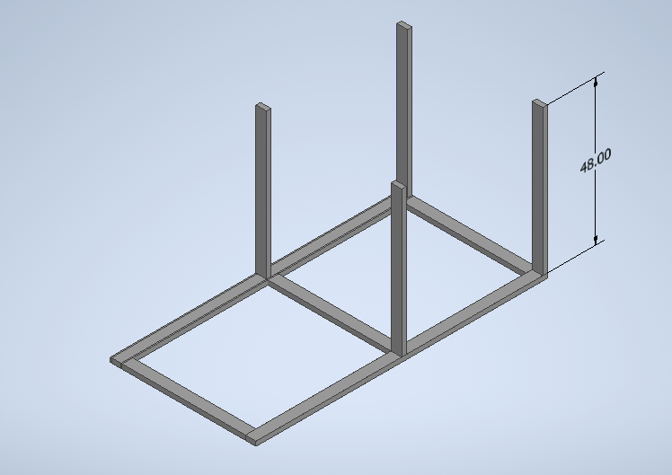
Supports
(4) 48”

Slide 6
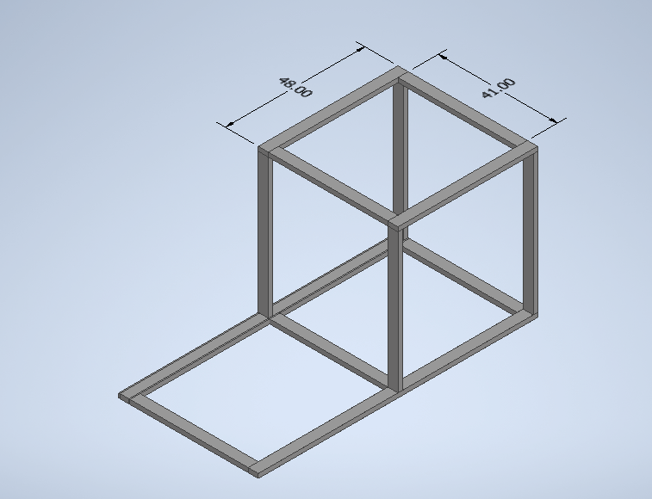
Roof
(2) 48”
(2) 41”

Slide 7
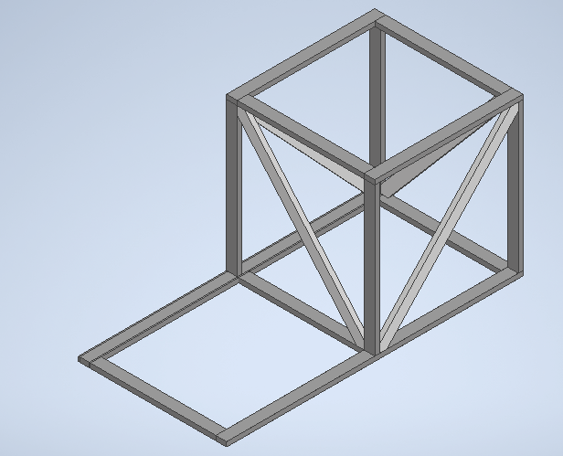
Inner Diagonals
(4) S66

Slide 8
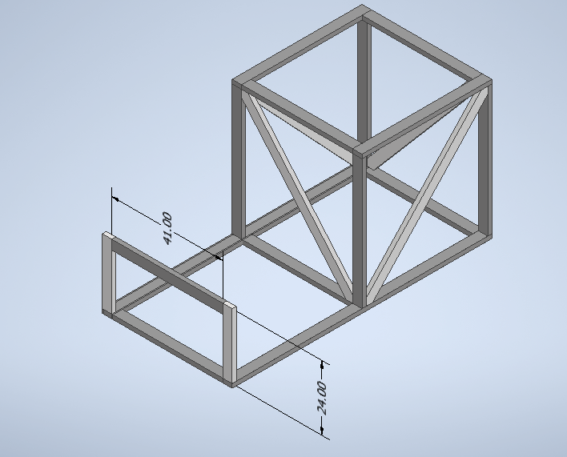
Claw area
(2) 24”
(1) 41”

Slide 9
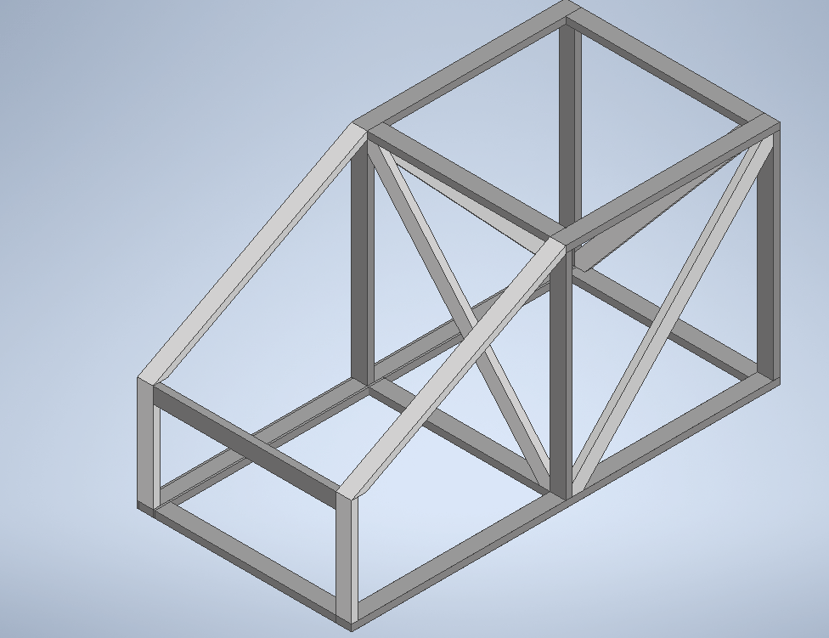
Front Diagonal
(2) S55

Slide 10
CONGRATS!!
Now the other Front Foot!

